Slide 1
VOID INVADER
- Itec 102 – final project
Presented by:
Alcazar, john alex b.
Delatorre, Emmanuel S
Datuin, jhaztine laitrell

Slide 2
Project overview: Project duration: oct 27, 2024 – jan 1, 2025 team leader: john alex b. alcazar team members: Emmanuel s. Delatorre jhaztine laitrell datuin

Slide 3
What is the purpose of our project?
Goal: Engaging gaming experience
Style: Retro console interface
Target Audience: Gamers seeking nostalgia

Slide 4
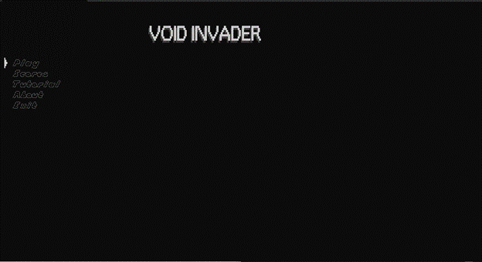
Key features
Main Menu: Players can navigate through options like Play, Scores, Tutorial, About, and Exit using keyboard inputs

Slide 5

Key features
Game Mechanics: Players control their character using W, A, S, D keys for movement and Space for shooting. They can also collect life cubes to increase their life.

Slide 6
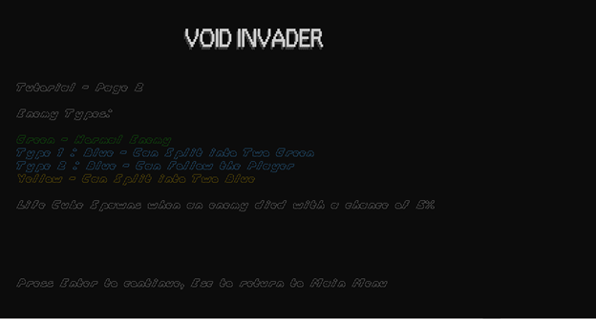
Key features
Enemies: The game includes various enemy types with different behaviors, such as normal, splitting, and following enemies.

Slide 7
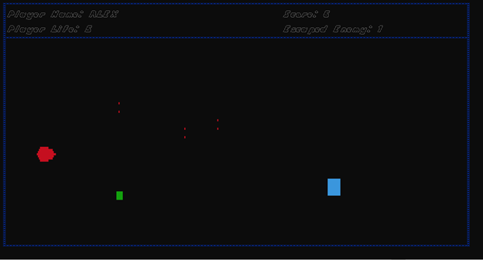
Key features
Game Display: Real-time display of player information, including name, life, score, and escaped enemies, is rendered in a retro-style console format."

Slide 8
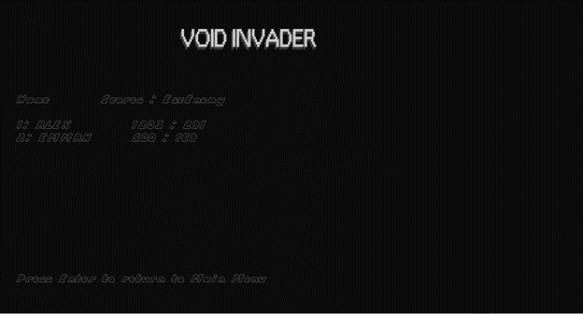
User interface

Slide 9
Technical Aspects
Coding Standards: Maintainability and readability
Key Functions: Initialization, movement, collision detection
Challenges: Smooth gameplay, sound management

Slide 10
Testing
Methods: Extensive testing for functionality
Focus Areas: Game initialization, controls, collision detection

Slide 11
Future Enhancements
Ideas:
Improved enemy AI
Additional levels or story mode
Customizable controls

Slide 12
Thank You for Listening

